Slide 1

Take your network Farther with Transition Networks
Introduction of Automated Testing in DVT
Mark Wang
Sep 2011

Slide 2
Agenda
Automated testing overall
Environment configuration
Automated testing architecture
API overall
Run/Edit test suit
Check test result
DVT test suits overall

Slide 3
Automated testing overall (1/1)
Program Language:
  TCL/TK based
Environment:
  Current only can be used on windows system
  Do not testing on other Operation System
Execution:
  CLI (Command Line Interface) based
Supported 3rd Part Instruments:
  Ixia layer2 function
Test Scope:
  ION product - through CLI commands
  Can not test Web and Focal Point

Slide 4
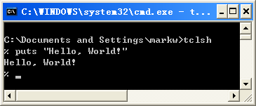
Environment configuration (1/1)
Download ActiveTcl and install (recommend revision 8.4.xxx)
  http://www.activestate.com/activetcl/downloads
Download the automated testing scripts from SVN server
  http://172.16.44.60/svn/automation/dvt/
Open CLI (Command Line Interface) and type the command:
  puts “Hello, World!”
  The output will be “Hello, World!”
Use notepad++ to edit test scripts
Environment configuration OK!

Slide 5
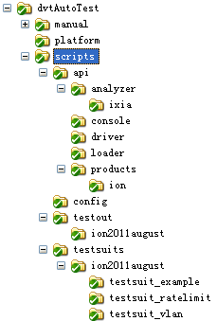
Automated testing architecture (1/3)
The folder introduction
This folder mapping with the “dvt” folder in SVN
dvtAutoTest/: The root directory of DVT automated testing, it include three folders as following
  manual/: save all of the automated testing document
  platform/: empty now, maybe used in further
  scripts/: save all of the test scripts and test result file
“scripts” folder is the current relative path of all scripts

Slide 6
Automated testing architecture (2/3)
The folders in scripts folder
api/:
  analyzer/: all of the analyzer’s API, such as IXIA analyzer
  console/: save console related API (not ready currently)
  driver/: save the expect and utility scripts
  loader/: save the loader and navigator scripts
  products/: save all product related scripts, such as ION’s API
config/:
  save the global variable in config.tcl file
testout/:
  ion2011august/:
    username/
testsuits/:
  ion2011august/: save all of the test suits which belong to ION 2011 August release
    testsuit_xxx/: the test suit folder, it include the test suit scripts and test suit parameters config file
  ion2011december/: Maybe used for ION 2011 December release, do not created now
startrun.tcl:
  the interface of run test suit, can run one or more test suits by sequence

Slide 7
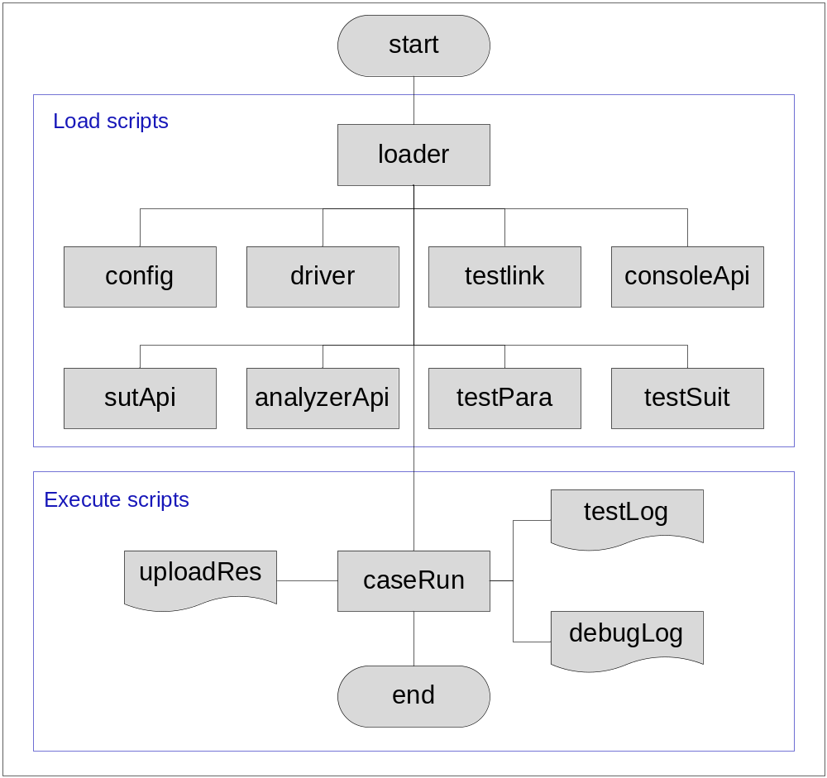
Automated testing architecture (3/3)
Function chart

Slide 8
API overall (1/8)
API introduction
API: Application Programming Interface
API is the base unit of automated testing, all of the action will be done by API

Slide 9
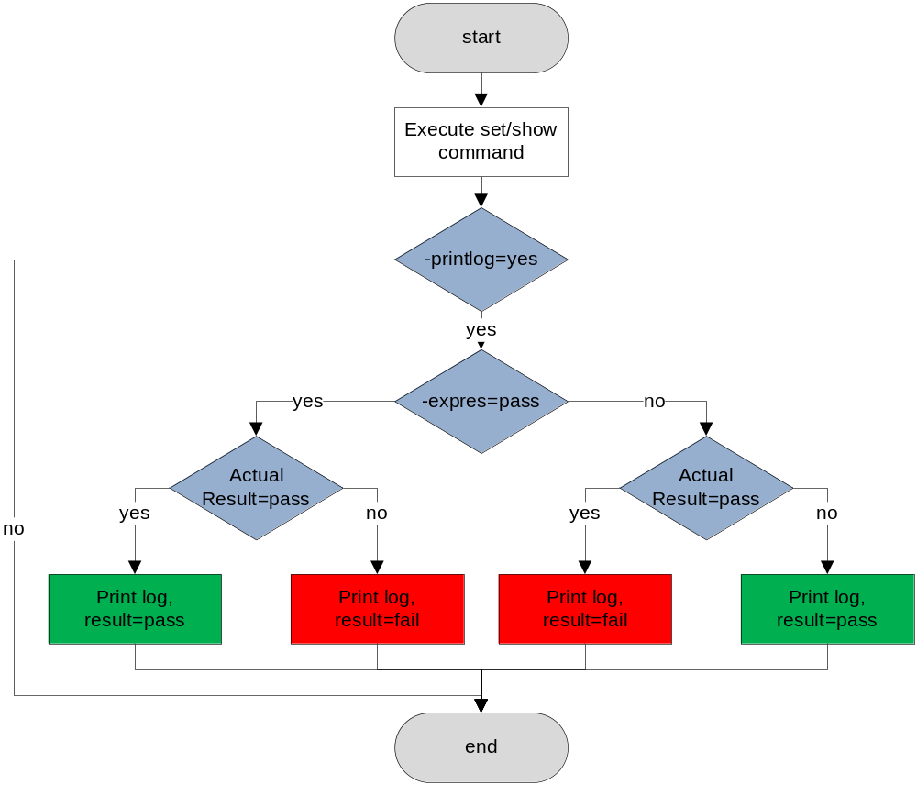
API overall (2/8)
The judgment process of API
Actual Result | Expected Result | Printed Result
Pass | Pass | Pass
Pass | Fail | Fail
Fail | Pass | Fail
Fail | Fail | Pass
uController -printlog yes -expres pass

Slide 10
API overall (3/8)
The current available APIs
All set related APIs:
  The “set” means do some configuration for SUT, the command starts with the following command:
    add
    set (will use “sets” instead of set when coding scripts)
    remove
    reset
    go
    Will support more commands in further
All get related APIs:
  The “get” means only get some information from SUT, do not do any configuration, the command starts with the following command:
    show
    Till now, DVT automated test scripts only support several show commands, please find detail command from “Automated Testing SUT API User Guide.doc” which located in:
    http://172.16.44.60/svn/automation/dvt/manual/scripts%20docs/
IXIA analyzer related APIs:
  Please refer “Automated Testing IXIA API User Guide.doc” which located in:
  http://172.16.44.60/svn/automation/dvt/manual/scripts%20docs/

Slide 11
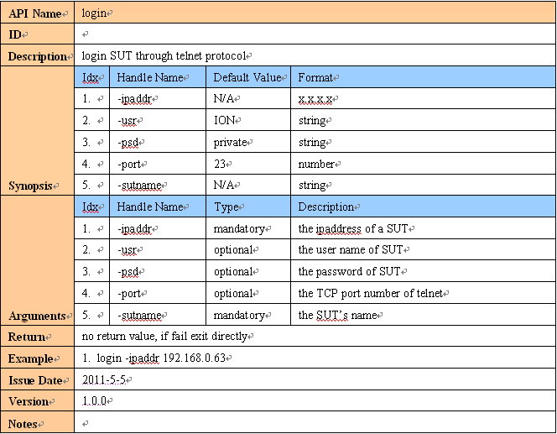
API overall (4/8)
API documents – example: login

Slide 12
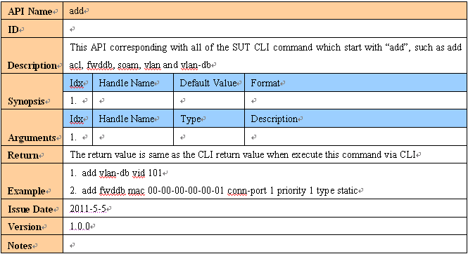
API overall (5/8)
API documents – example: add

Slide 13
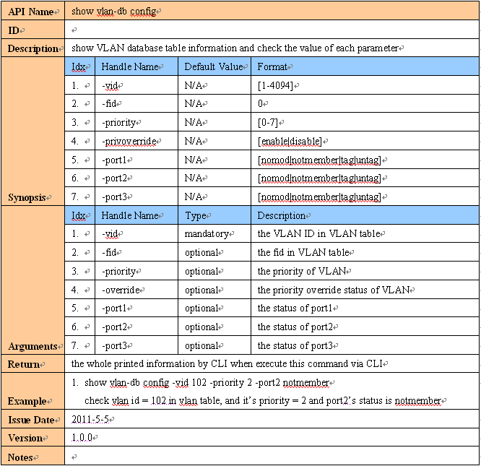
API overall(6/8)
API documents – example: show vlan-db config

Slide 14
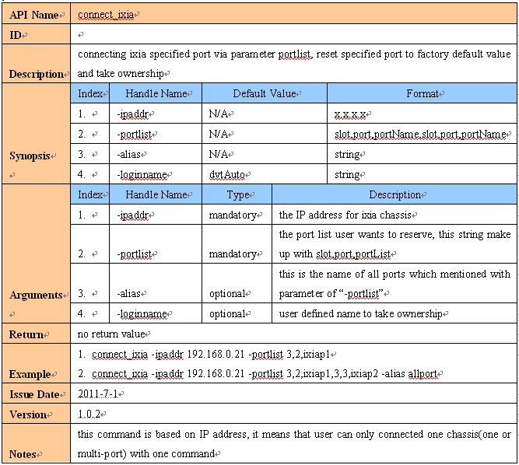
API overall (7/8)
API documents – example: connect_ixia

Slide 15
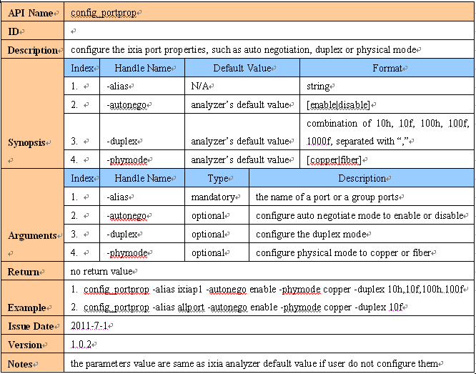
API overall (8/8)
API documents – example: config_portprop

Slide 16
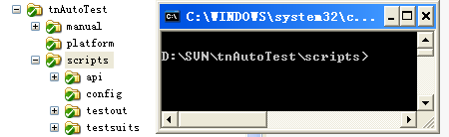
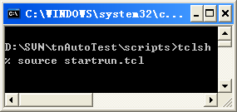
Run/Edit test suit (1/4)
The major steps to run test suit
Open and edit startrun.tcl file
  Location: scripts/ (..)
  For example, if user want to run testsuit_example which existed in ion2011august, the config as next line
  runTestSuit -tester username -prjname ion2011august -tsname testsuit_example -tclist 1-4
Open and edit test suit and test suit parameters config file
  Location: ./testsuits/ion2011august/testsuit_example/
  Please see the test scripts in file testsuit_example.tcl
  Please edit the test suit parameters in file testsuit_example_para.tcl
Open CLI (command line interface) and set current directory same as the “scripts” folder which downloaded from SVN
Type “tclsh” in CLI
Type “source startrun.tcl” in TCL interpreter
The scripts will be executed automatically

Slide 17
Run/Edit test suit (2/4)
The major steps to create test suit
New create a project folder in “test suits” folder if needed
  For example, create a folder “ion2011december” for ION 2011 December release in folder “./testsuits”
Created a test suit folder in project folder
  For example, create a folder named with “testsuit_example1” in folder “./testsuit/ion2011august”
Create test suit file in test suit folder
  For example, create “testsuit_example1.tcl” and “testsuit_example1_para.tcl” in folder “./testsuit/ion2011august/ testsuit_example1”
We recommended use “testsuit_” as the prefix of testsuit folder and testsuit file

Slide 18
Run/Edit test suit (3/4)
The major steps to edit test scripts – the first test case in test suit
Recommended the first test case only connected SUT or IXIA, and configure global configuration or parameters for all test cases which will be executed
Recommended run this test case at first
# Testcase 1 - login system
proc example_1 {} {
# login SUT
login -ipaddr $::sut1Ip -sutname sut1
# connect ixia analyzer
connect_ixia -ipaddr $::ixiaIp -portlist $::ixiaPort1,ixiap1 -alias allport
# do some configurations for all test cases
# ...
}
# Testcase1’s parameter
proc example_1_para {} {
set ::sut1Ip 192.168.0.61
set ::sut1Slot1 11
set ::ixiaIp 192.168.0.21
set ::ixiaPort1 3,5
set ::ixiaPort2 3,6
set ::ixiaPhyMode copper
}

Slide 19
Run/Edit test suit (4/4)
The major steps to edit test scripts – general test case
# Testcase n – general test case
proc example_n {} {
# use api to get/set some parameters
#or use tcl language to realize yourself method
}

Slide 20
Check test result (1/1)
Location: ./testout/$projectFolder/$userName
  Test case log:
    Record all of the steps of configuration or check item
  Debug log:
    Some exception information will be recorded in this file when error

Slide 21
DVT test suits overall (1/1)
Available test suits now
  VLAN
  QoS
  Rate Limit
Plan to develop test suits by this year
  MAC
  Counter
Plan to develop test suits in further
  Provisioning (backup & restore)
  Performance Testing

Slide 22
Agenda
Automated testing overall
Environment configuration
Automated testing architecture
API overall
Run/Edit test suit
Check test result
DVT test suits overall
Any Suggestion & Question?

Slide 23
Take your network Farther with Transition Networks
Thank You

